Slide 1

COS202 • GROUP 9 PROJECT PROPOSAL
Smart Drainage
Monitoring and
Flood Alert System
SDMFAS
A Community-Driven Digital Platform for Flood Detection, Reporting, and Response
CASE STUDY / LAGOS STATE

Slide 2
COS202 / GROUP 9
02 / 11
Team Members
S/N
MATRIC NUMBER
NAME
DEPARTMENT
1
240805057
Oyetimehin Ibukunoluwa
Computer Science
2
240805051
Atanda Praise Kehinde
Computer Science
3
240805028
Olayinka Idrak Olamiji • Team Captain
Computer Science
4
240805084
Omilabu Ahmad
Computer Science
5
240806097
Moshood Jamaldeen
Mathematics
6
240817042
Sadiq Fuad Oluwaseyi
Data Science
7
240817006
Nnani Chibuzo Micah
Data Science
8
240817014
Oriola Abdullahi Adeola
Data Science
9
240313006
Jacob Grace Oyinyechi • Asst. Captain
Mathematics Education
10
252605501
Amechi Chibueze
Mathematics
11
252609505
Shodipe-Dosunmu Adeola
Data Science

Slide 3
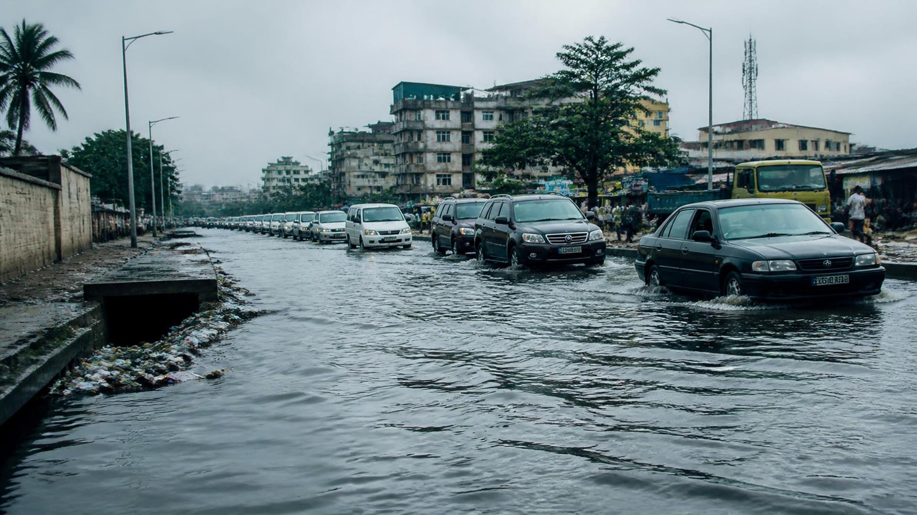
COS202 / GROUP 9
03 / 11
The Problem
Flooding is recurring — but reporting remains fragmented.
LEKKI • AJAH • APAPA
IYANA-IPAJA • AGEGE
Blocked drains, silt build-up and illegal dumping compound delayed maintenance response.
Flooded Lagos streets / drainage pressure

Slide 4
COS202 / GROUP 9
04 / 11
Why It Matters
₦
+
!
ECONOMY
HEALTH
SAFETY
Disrupted commerce, commutes and livelihoods.
Stagnant floodwater raises statewide public-health risks.
Pedestrians and motorists face hidden, fast-moving hazards.
A drainage failure becomes an economic, safety and health crisis.

Slide 5
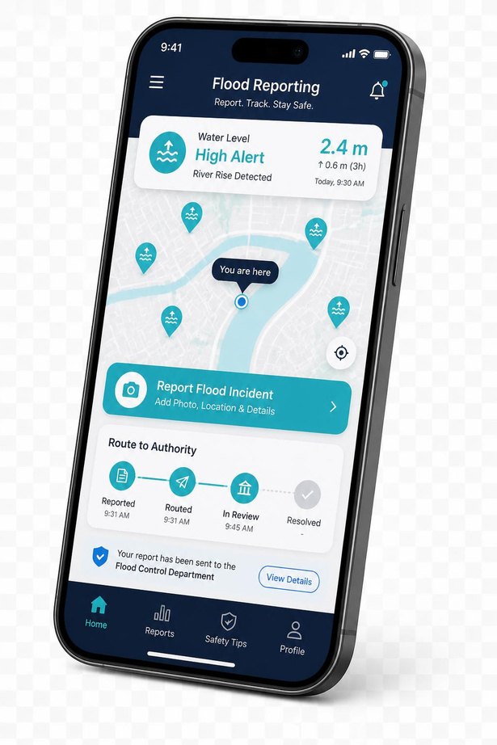
COS202 / GROUP 9
05 / 11
Our Solution
One platform.
From street report
to public response.
01 REPORT → 02 ROUTE → 03 ALERT
Residents, commuters and businesses submit a location, photo and description. SDMFAS routes the incident to the responsible LGA and updates a public flood-status dashboard.

Slide 6
COS202 / GROUP 9
06 / 11
Alignment with Project Criteria
01
02
03
LOCALIZED
IMPACTFUL
SDG-LINKED
Routes reports to Lagos’s 20 LGAs at neighborhood level for targeted action.
Turns community reports into actionable data for residents and public agencies.
Directly supports SDG 11 — Cities and SDG 13 — Climate Action.

Slide 7
COS202 / GROUP 9
07 / 11
SDG Alignment
11
13
SUSTAINABLE CITIES
AND COMMUNITIES
CLIMATE ACTION
Enhances urban resilience through smarter drainage monitoring and faster flood response across Lagos State.
Supports climate adaptation through data-driven alerts, incident evidence and preventive maintenance.

Slide 8
COS202 / GROUP 9
08 / 11
Project Objectives
01
02
Accessible flood and drainage issue reporting
Prompt routing to the appropriate LGA authority
03
04
Real-time public flood status and safety alerts
Statewide data for preventive, long-term management

Slide 9
COS202 / GROUP 9
09 / 11
Scope and Approach
REFERENCE SITE
01
Lagos State + 20 LGAs
CORE USERS
02
Residents, commuters, businesses, LGA officials
CORE FEATURES
03
Mobile/web reporting, automated routing, public alerts
EXPECTED OUTPUT
04
Functional prototype piloted in representative LGAs

Slide 10
COS202 / GROUP 9
10 / 11
Expected Outcomes
FASTER
SAFER
Drain clearing and response
Movement during flood events
SMARTER
STRONGER
A reliable incident evidence base
Resident–LGA collaboration

Slide 11
COS202 / GROUP 9
Detect earlier.
Respond faster.
Build a flood-resilient Lagos.
11
SUSTAINABLE CITIES
13
CLIMATE ACTION
SDMFAS connects community intelligence with public action — improving safety, infrastructure upkeep and climate resilience.
COMMUNITY REPORTING → PUBLIC RESPONSE

